Slide 1

Modern and Improved Critique System
Just a website Idea
By
Jeevan0863

Slide 2

“Time doesn’t change
Time reveals.”
Contents
0. Introduction and idea ( Ideology )
Past Critique system
Modern Critique system (1-2 Problem statement with case study)
Problems ( Problems listed )
Possible solutions (Listed solutions with effects)
Idea Implementation
No absolute system (ideas and thoughts on Future)

Slide 3

Introduction
Introspective and retrospective
What’s the meaning of these two word.
Retrospective is the critique or examining of past acts, works with present wisdom or knowledge.
Introspective is the critique or examining of present acts, work with past wisdom or knowledge.
Ever heard anyone saw “Modern film/tv/games is bad these days or as not good as past ”. If u look at review, they look similar/better than past. Then what the problem here? Why is there a conflict between past and present work even if present work is in every way better than past. Plot thickens. Problem is that review system employed to critique is outdated, inconsistence, inflated and importantly being too simple.
We try to introspect the present/modern title with past knowledge.

Slide 4
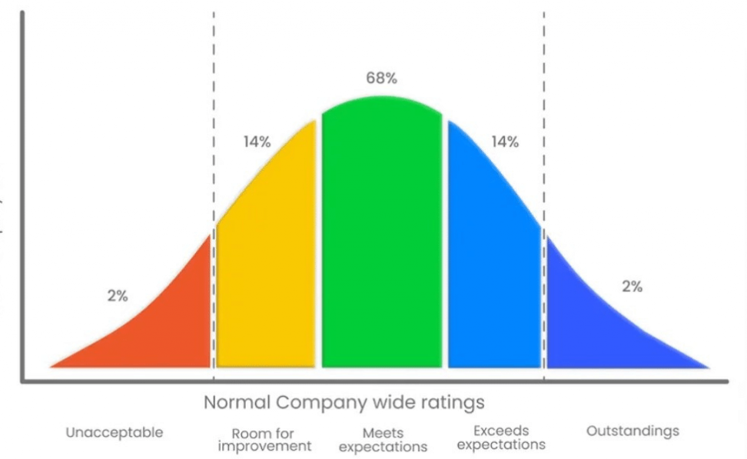
Past critique system
Review systems were first employed to judge the quality of a product with numbers. At first they were successful at there task. Making choice and judgement easy for consumer. But then they were used to review artistic products. But,
“Art is subjective.”
Art is so subjective that sometimes it’s better to not give a definitive score but rather an alphabet or a region.
But it does the job as past works were simple and mainly not as dominant and competitive as today.
This review distribution is perfect for Products as its elegance lies with its context interpretation. A three star is not too bad and not too good, it meets average criteria/ expectations.

Slide 5
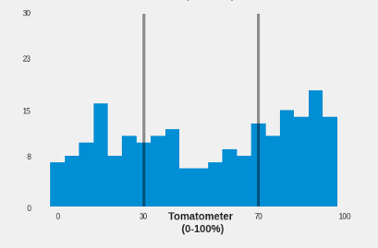
Modern critique system
Rotten Tomatoes Case study
This distribution is not easy to interpret in context, because the tomatometer it’s not a classical rating, but rather represents the percentage of critics who gave a positive review to a movie. Anyway, I guess it should still boil down to the same normal distribution, with most of the movies having a moderate difference between the number of positive reviews and the negative ones (rendering many ratings of 30% — 70% positive reviews), and a few movies having a significantly bigger difference, in one way or the other.
Metacritic is a well know website known for its review of entertainment media. It rates films, video games, book(?) and many more I have no interest in. It's scores 'the product' with a rating i against 100. Then based on i , and which predetermined region (for games and films it's different) it falls into as
"Universally Acclaimed : 100 - 90 games, 100-81 other"
"Generally favorable : 89-75 games, 80-61 others" "Mixed reception : 74-50 games, 60-40 others" "Generally Unfavorable : 49-20 games, 39-20 others" "Overwhelming Dislike :19-0 for all"
The context interpretation is ruined. A 75% rated product is average due to increasing bar of average criteria/ expectations.
This system is unfit for the bad-average-good qualitative framework, because it makes movies either good, either bad.
the tomatometer’s distribution is unexpectedly uniform, and would look even flatter under a different binning strategy (a binning strategy is defined by the total number of bars and their ranges)
Problem statement
Note: Can show more case study with more specific problems and examples but not here.

Slide 6
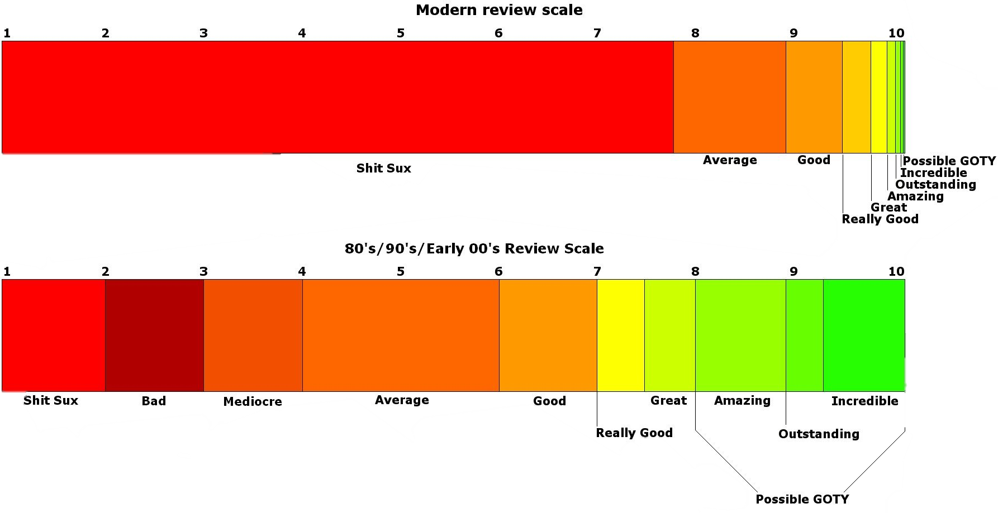
Problems
1. No clear difference between Intrinsic and extrinsic reviewing.
2. Inconsistence in rating two products.(retrospective problem)
3. Inflated median that increase over time leading good-average-bad system
to good-bad.
4. Over competition leading to overshadowing of unique and original which
are never heard

Slide 7
Solutions (with how it accomplishes at solving problem)
Add a time variable.
A time variable which changes (increasing/ decreasing gradually) score over time (user review are already dynamic.)
a. This will add the retrospective aspect to reviews, and show the relevance of the work in contemporary days more faithfully. (key is too
change gradually.)
b. A gem of movie will have it’s score increase with time, while a (bad) film made success due to hype will have it’s score decrease with
time to remove from the competition of good movies, while leaving a good impression. This effectively corrects the score with present
day.
Add a dynamic audience circle.
We are in 2020’s not in clone wars. So everybody have interests and favourite genre. Past systems ask your personal favourite
genre at beginning and (barely) update them as user uses the system. We will add Audience circles which will segregate people interested in
genre and group them to survey and etc. They shall receive extra weight in review system when they score a movie leading to a balanced
system. This system is already used in recommendation section.
3. Changing the score scale.
a. The extrinsic (critique) review score will be 0-100 similar to metacritique with add alphabet extension beside to represent Artistic
nature of product.
b. the intrinsic (user) review score will be from -5 to 5 which
1. Expands the range to accommodate a wide differences in views.
2. Drops the inflated median (its at 2-4) back to normal(1.5-3), which improves the context interpretation.
Movie tags
Movie tags already exists such as ‘must watch’, ‘masterpiece’, ‘classic’. But we add more of them and important part of intrinsic
reviewing.
Yeah many more in thought process…

Slide 8

89-A
If movie is still good after many years
92 - A
Extrinsic (critique) Review
A movie releases
With time
2.5
4.5
Intrinsic (Audience) Review
movie was good and audience treated it badly at launch
5 – 3.75
3.75 -
2.5
2.5 -1
i - x
Critique score
i will range from 0-100
It works as others systems
1 to -1
Audience score
X ranges from A to F used to show Artistic nature of film.
-5 –
-3.75
-3.75 –
-2.5
-2.5 -
-1

Slide 9
No Absolute System
This last slide is meant to show the unavoidable flaws and cons face by every system and is more thought based.
“Art is subjective”
So, there is no perfect or imperfect in an individual view. We simply need not to judge it, but rather Enjoy it. But as we are the monkeys that count rocks to judge who has the most rocks, we judge everything. We try to find meaning and context from everything eyes can see, ears can listen to deep emotions we feel. And art is something that intrigues the mind. We judge art to show how much we love one over another and how this one is better than other.
That is intrinsic reviewing. It is simple, u love favourite thing and just love it. Others have other favourite things and they love it. Your review/opinion doesn’t bother them and theirs doesn’t bother you same way.(until unless you are a mad scientists about to change course of history with your research.)
Problem with extrinsic review is ‘It TRULY doesn’t matter’ for an individual to not love an bad art/work. But modern monkeys are different in every sense and way that past monkeys that built this system are. We just have too much good art. And too much bad art. We just want to differentiate what is good or bad not which is good or bad.
Our systems might show if something is good and if so we give it a try. No more argument. It feels dumb to chase the ultimate critique of a product when you love it. May be Intrinsic critique plays important role in modern review system then Extrinsic critique. That’s all we may need. An Intrinsic love.

Slide 10
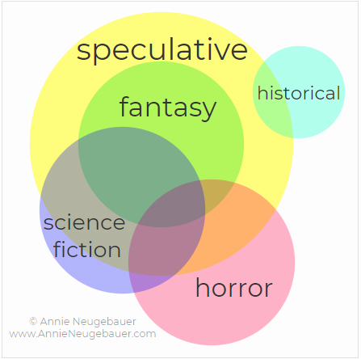
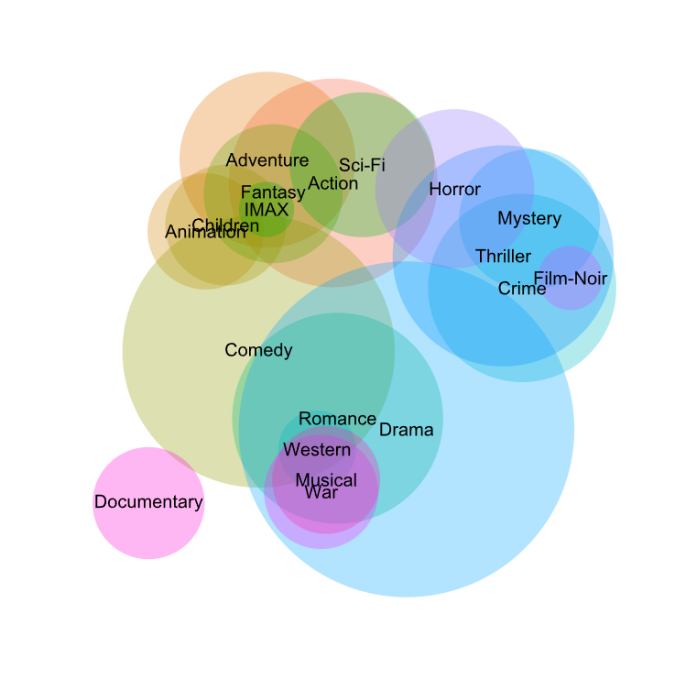
Audience Circles
Speculative
fantasy
Historical
Horror
Science
fiction

